Slide 1
java.util : The Collections Framework

Slide 2
Java.util Package. It contains the collections framework, legacy collection classes, event model, date and time facilities, internationalization, and miscellaneous utility classes (a string tokenizer, a random-number generator, and a bit array).

Slide 3
Collections Framework
The java.util package also contains one of Java’s most powerful subsystems: The Collections Framework.
The Collections Framework is a sophisticated hierarchy of interfaces and classes that provide state-of-the-art technology for managing groups of objects.
It merits close attention by all programmers.

Slide 4
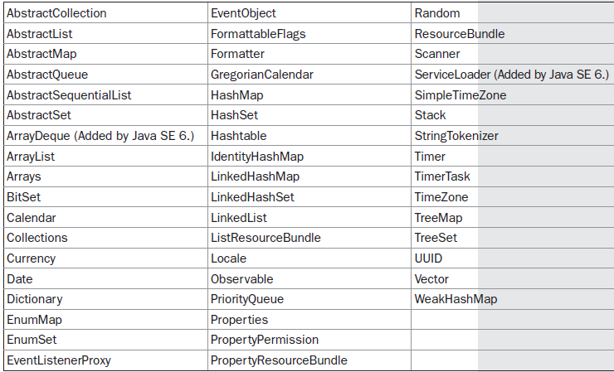
java.util contains a wide array of functionality, it is quite large

Slide 5
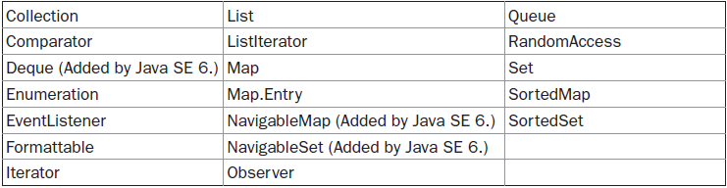
Some of the interfaces defined by java.util are
Here we discuss and examine those members of java.util that are the part of the Collections Framework.

Slide 6
Collection Overview
The Java Collections Framework standardizes the way in which groups of objects are handled by your programs.
Prior to the Collections Framework, Java provided ad hoc classes such as Dictionary, Vector, Stack, and Properties to store and manipulate groups of objects.
The Collections Framework was designed to meet several goals.
First, the framework had to be high-performance.
The implementations for the fundamental collections are highly efficient.

Slide 7
Second, the framework had to allow different types of collections to work in a similar manner and with a high degree of interoperability.
Third, extending and/or adapting a collection had to be easy. The entire Collections Framework is built upon a set of standard interfaces.
Several standard implementations (such as Linked List, Hash Set, and Tree Set) of these interfaces are also provided.
You may also implement your own collection, if you choose. Various special-purpose implementations are created.
Finally, mechanisms were added that allow the integration of standard arrays into the Collections Framework.

Slide 8
Algorithms are another important part of the collection mechanism. Algorithms operate on collections and are defined as static methods within the Collections class.
They provide a standard means of manipulating collections.
Another item closely associated with the Collections Framework is the Iterator interface.
An iterator offers a general-purpose, standardized way of accessing the elements within a collection, one at a time.
Thus, an iterator provides a means of enumerating the contents of a collection.

Slide 9
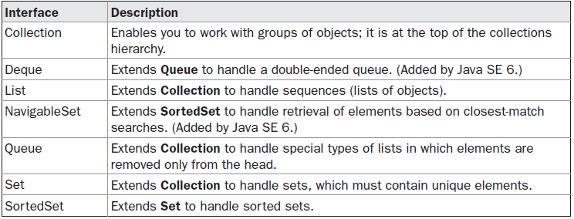
The Collection Interfaces
The Collections Framework defines several interfaces.
Collection interfaces is necessary because they determine the fundamental nature of the collection classes.
Some of the interfaces are:

Slide 10
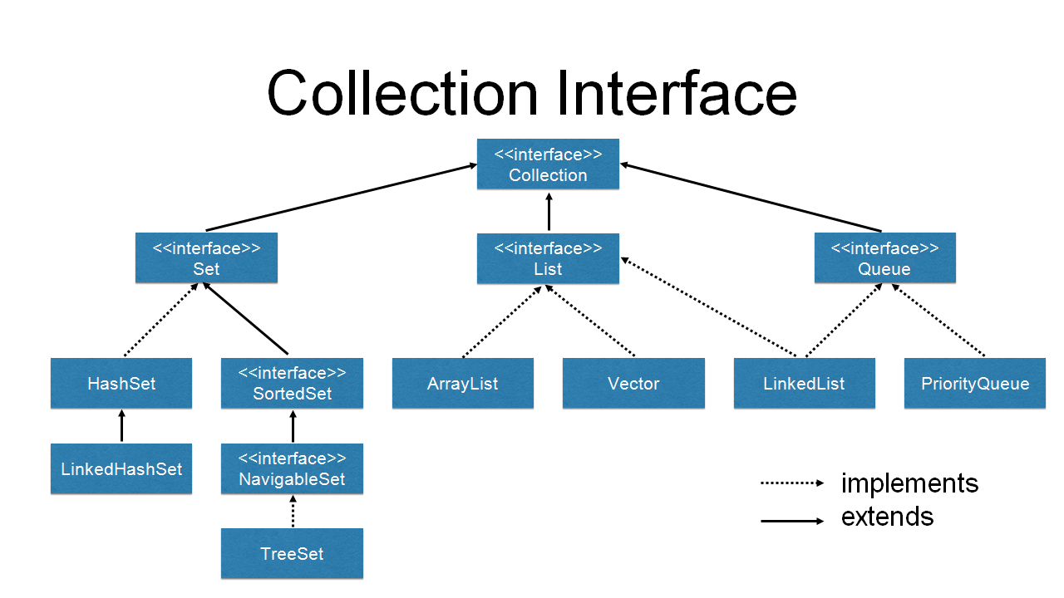

Slide 11
In addition to the collection interfaces, collections also use the
Comparator : that defines how two objects are compared
RandomAccess: By implementing Random Access, a list indicates that it supports efficient, random access to its elements.
Iterator, and ListIterator interfaces: enumerate the objects within a collection.

Slide 12
To provide the greatest flexibility in their use, the collection interfaces allow some methods to be optional.
The optional methods enable you to modify the contents of a collection.
Collections that support these methods are called modifiable.
Collections that do not allow their contents to be changed are called unmodifiable. If an attempt is made to use one of these
methods on an unmodifiable collection, an UnsupportedOperationException is thrown.
All the built-in collections are modifiable.

Slide 13
The collection Interface:
The Collection interface is the foundation upon which the Collections Framework is built because it must be implemented by any class that defines a collection.
Collection is a generic interface that has this declaration:
interface Collection<E>
Here, E specifies the type of objects that the collection will hold.
Collection extends the Iterable interface.
This means that all collections can be cycled through by use of the for-each style for loop.

Slide 14
Collection declares the core methods that all collections will have.
Since, all collections implement Collection, familiarity with its methods is necessary for a clear understanding of the framework.
Several of these methods can throw an UnsupportedOperationException.
this occurs if a collection cannot be modified.
AClassCastException is generated when one object is incompatible with another, such as when an attempt is made to add an incompatible object to a collection.

Slide 15
A NullPointerException is thrown if an attempt is made to store a null object and null elements are not allowed in the collection.
An IllegalArgumentException is thrown if an invalid argument is used.
An IllegalStateException is thrown if an attempt is made to add an element to a fixed-length collection that is full.

Slide 16
Objects are added to a collection by calling add( ).
Notice that add( ) takes an argument of type E, which means that objects added to a collection
It must be compatible with the type of data expected by the collection.
You can add the entire contents of one collection to another by calling addAll( ).
You can remove an object by using remove( ).
To remove a group of objects, call removeAll( ).
You can remove all elements except those of a specified group by calling retainAll( ).
To empty a collection, call clear( ).

Slide 17
You can determine whether a collection contains a specific object by calling contains( ).
To determine whether one collection contains all the members of another, call containsAll( ).
You can determine when a collection is empty by calling isEmpty( ).
The number of elements currently held in a collection can be determined by calling size( ).
The toArray( ) methods return an array that contains the elements stored in the invoking collection.
The first returns an array of Object.
The second returns an array of elements that have the same type as the array specified as a parameter.
Normally, the second form is more convenient because it returns the desired array type. These methods are more important than it might at first seem. Often, processing the contents of a collection by using array-like syntax is advantageous. By providing a pathway between collections and arrays, you can have the best of both worlds.

Slide 18
Two collections can be compared for equality by calling equals( ).
The precise meaning of “equality” may differ from collection to collection. For example, you can implement equals( ) so that it compares the values of elements stored in the collection.
Alternatively, equals( ) can compare references to those elements.
One more very important method is iterator( ), which returns an iterator to a collection.
Iterator’s are frequently used when working with collections.

Slide 19
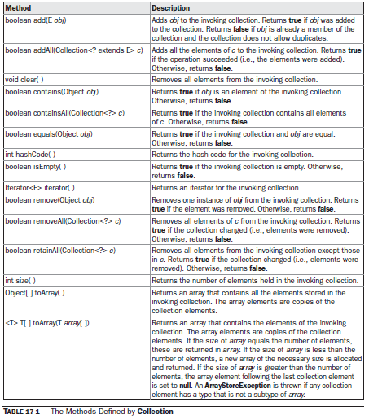

Slide 20
The List Interface
The List interface extends Collection and declares the behavior of a collection that stores a sequence of elements.
List is a generic interface that has this declaration:
interface List<E>
Here, E specifies the type of objects that the list will hold.
List defines some of its own methods.
These methods will throw an UnsupportedOperationException
if the list cannot be modified, and a ClassCastException is generated when one object is incompatible with another.

Slide 21
several methods will throw an IndexOutOfBoundsException if an invalid index is used.
A NullPointerException is thrown if an attempt is made to store a null object and null elements are not allowed in the list.
An IllegalArgumentException is thrown if an invalid argument is used.
To the versions of add( ) and addAll( ) defined by Collection, List adds the methods add(int, E) and addAll(int, Collection).
the semantics of add(E) and addAll(Collection) defined by Collection are changed by List
so that they add elements to the end of the list.

Slide 22
To obtain the object stored at a specific location, call get( ) with the index of the object.
To assign a value to an element in the list, call set( ), specifying the index of the object to be changed.
To find the index of an object, use indexOf( ) or lastIndexOf( ).
You can obtain a sublist of a list by calling subList( ), specifying the beginning and ending indexes of the sublist.
As you can imagine, subList( ) makes list processing quite convenient.

Slide 23
The Set Interface
The Set interface defines a set.
It extends Collection and declares the behaviour of a collection that does not allow duplicate elements.
Therefore, the add( ) method returns false if an attempt is made to add duplicate elements to a set. It does not define any additional methods of its own.
Set is a generic interface that has this declaration:
interface Set<E>
Here, E specifies the type of objects that the set will hold.

Slide 24
The SortedSet Interface
The SortedSet interface extends Set and declares the behavior of a set sorted in ascending order.
SortedSet is a generic interface that has this declaration:
interface SortedSet<E>
Here, E specifies the type of objects that the set will hold.
In addition to those methods defined by Set, the SortedSet interface declares the methods

Slide 25
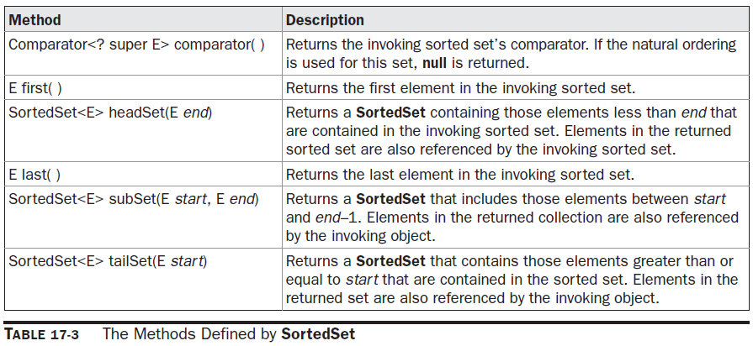

Slide 26
Several methods throw a NoSuchElementException when no items are contained in the invoking set.
A ClassCastException is thrown when an object is incompatible with the elements in a set.
ANullPointerException is thrown if an attempt is
made to use a null object and null is not allowed in the set.
An IllegalArgumentException is thrown if an invalid argument is used.

Slide 27
SortedSet defines several methods that make set processing more convenient.
To obtain the first object in the set, call first( ).
To get the last element, use last( ).
You can obtain a subset of a sorted set by calling subSet( ), specifying the first and last object in the set.
If you need the subset that starts with the first element in the set, use headSet( ).
If you want the subset that ends the set, use tailSet( ).

Slide 28
The NavigableSet Interface
The NavigableSet interface was added by Java SE 6.
It extends SortedSet and declares the behaviour of a collection that supports the retrieval of elements based on the closest match to a given value or values.
NavigableSet is a generic interface that has this declaration:
interface NavigableSet<E>
Here, E specifies the type of objects that the set will hold.
In addition to the methods that it inherits from SortedSet

Slide 29
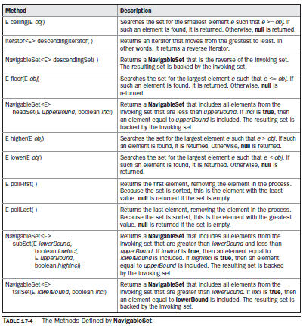
NavigableSet adds those summarized

Slide 30
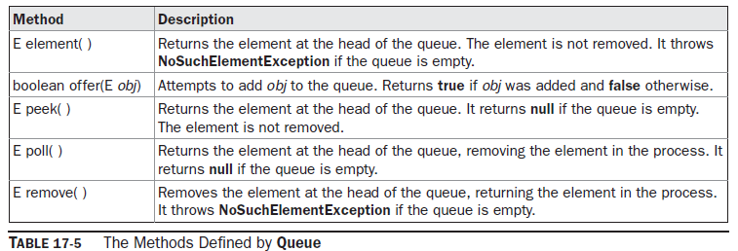
The Queue Interface
The Queue interface extends Collection and declares the behaviour of a queue, which is often a first-in, first-out list.
Queue is a generic interface that has this declaration:
interface Queue<E>

Slide 31
Several methods throw a ClassCastException when an object is incompatible with the elements in the queue.
A NullPointerException is thrown if an attempt is made to store a null object and null elements are not allowed in the queue.
An IllegalArgumentException is thrown if an invalid argument is used.
An IllegalStateException is thrown if an attempt is made to add an element to a fixed-length queue that is full.
A NoSuchElementException is thrown if an attempt is made to remove an element from an empty queue.

Slide 32
Despite its simplicity, Queue offers several points of interest.
First, elements can only be removed from the head of the queue.
Second, there are two methods that obtain and remove elements: poll( ) and remove( ).
The difference between them is that poll( ) returns null if the queue is empty, but remove( ) throws an exception.
Third, there are two methods, element( ) and peek( ), that obtain but don’t remove the element at the head of the queue.
They differ only in that element( ) throws an exception if the queue is empty, but peek( ) returns null.
Finally, notice that offer( ) only attempts to add an element to a queue. Because some queues have a fixed length and might be full, offer( ) can fail.

Slide 33
The Deque Interface
The Deque interface was added by Java SE 6.
It extends Queue and declares the behaviour of a double-ended queue.
Double-ended queues can function as standard, first-in, first-out queues or as last-in, first-out stacks.
Deque is a generic interface that has this declaration:
interface Deque<E>
Here, E specifies the type of objects that the deque will hold.
In addition to the methods that it inherits from Queue, Deque adds those methods summarized

Slide 34
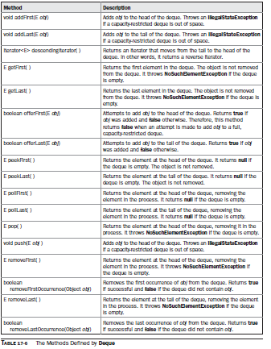

Slide 35
The Collection Classes
Now that you are familiar with the collection interfaces
ready to examine the standard classes that implement them
Some of the classes provide full Implementations that can be used as-is.
Others are abstract, providing skeletal implementations that are used as starting points for creating concrete collections.
The standard collection classes are summarized

Slide 36
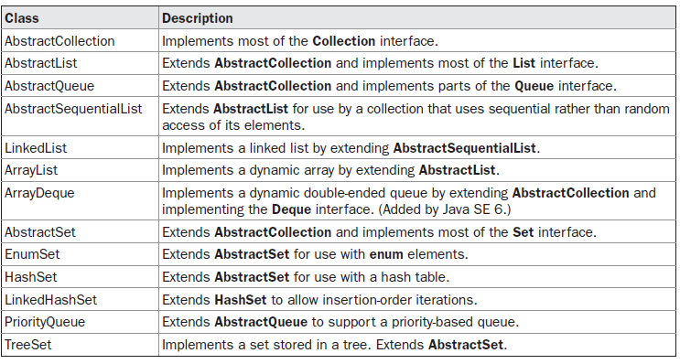

Slide 37
The ArrayList Class
The ArrayList class extends AbstractList and implements the List interface.
ArrayList is a generic class that has this declaration:
class ArrayList<E>
Here, E specifies the type of objects that the list will hold.
ArrayList supports dynamic arrays that can grow as needed.
In Java, standard arrays are of a fixed length.
After arrays are created, they cannot grow or shrink, which means that you must know in advance how many elements an array will hold.

Slide 38
Sometimes, you may not know until run time precisely how large an array you need.
To handle this situation, the Collections Framework defines ArrayList. In essence, an ArrayList is a variable-length array
of object references.
That is, an ArrayList can dynamically increase or decrease in size.

Slide 39
ArrayList has the constructors shown here:
ArrayList( )
ArrayList(Collection<? extends E> c)
ArrayList(int capacity)
The first constructor builds an empty array list.
The second constructor builds an array list that is initialized with the elements of the collection c.
The third constructor builds an array list that has the specified initial capacity.
The capacity is the size of the underlying array that is used to store the elements.
The capacity grows automatically as elements are added to an array list.

Slide 40
The following program shows a simple use of ArrayList.
An array list is created for objects of type String, and then several strings are added to it.
The list is then displayed. Some of the elements are removed and the list is displayed again.

Slide 41
Program ArrayListDemo

Slide 42
Notice that a1 starts out empty and grows as elements are added to it.
When elements are removed, its size is reduced.
In the preceding example, the contents of a collection are displayed using the default conversion provided by toString( ), which was inherited from AbstractCollection.
Although the capacity of an ArrayList object increases automatically as objects are stored in it,
We can increase the capacity of an ArrayList object manually by calling ensureCapacity( ).

Slide 43
If it might want to do this if you know in advance that you will be storing many more items in the collection than it can currently hold.
By increasing its capacity once, at the start, we can prevent several reallocations later.
Because reallocations are costly in terms of time, preventing unnecessary ones improves performance. The signature for ensureCapacity( ) is shown here:
void ensureCapacity(int cap)
Here, cap is the new capacity.

Slide 44
Conversely, if you want to reduce the size of the array that underlies an ArrayList object so that it is precisely as large as the number of items that it is currently holding, call trimToSize( ),
void trimToSize( )

Slide 45
Why ArrayList is better than Array?
The limitation with array is that it has a fixed length so if it is full you cannot add any more elements to it, likewise if there are number of elements gets removed from it the memory consumption would be the same as it doesn’t shrink.
On the other ArrayList can dynamically grow and shrink after addition and removal of elements. Apart from these benefits ArrayList class enables us to use predefined methods of it which makes our task easy.

Slide 46
How to create an ArrayList?
We can create an ArrayList by writing a simple statement like this:
This statement creates an ArrayList with the name alist OR aL with type “String”. The type determines which type of elements the list will have. Since this list is of “String” type, the elements that are going to be added to this list will be of type “String”.
ArrayList<String>alist=new ArrayList<String>( );
Similarly we can create ArrayList that accepts int elements.
ArrayList<Integer>list=new ArrayList<Integer>( );

Slide 47
How to add elements to an ArrayList?
We add elements to an ArrayList by using add() method, this method has couple of variations, which we can use based on the requirement.
For example: If we want to add the element at the end of the List then simply do it like this:
alist.add("Steve"); //This will add "Steve" at the end of List
To add the element at the specified location in ArrayList, we can specify the index in the add method like this:
alist.add(3, "Steve"); //This will add "Steve" at the fourth position

Slide 48
Program: JavaExample

Slide 49
How to remove elements from ArrayList?
We use remove() method to remove elements from an ArrayList
Program: JavaExample1
Program:AddRemove

Slide 50
Obtaining an Array from an ArrayList
When working with ArrayList, sometimes we want to obtain an actual array that contains the contents of the list.
We can do this by calling toArray( ), which is defined by Collection.
Reasons exist why we might want to convert a collection into an array, such as:
To obtain faster processing times for certain operations
To pass an array to a method that is not overloaded to accept a collection
To integrate collection-based code with legacy code that does not understand collections

Slide 51
There are two versions of toArray( ), which are shown again here for our convenience:
Object[ ] toArray( )
<T> T[ ] toArray(T array[ ])
The first returns an array of Object.
The second returns an array of elements that have the
same type as T.
Normally, the second form is more convenient because it returns the proper type of array.
The following program demonstrates its use:

Slide 52
Program: ArrayListToArray

Slide 53
The program begins by creating a collection of integers.
Next, toArray( ) is called and it obtains an array of Integers.
Then, the contents of that array are summed by use of a for-each style for loop.
There is something else of interest in this program.
As you know, collections can store only references to, not values of, primitive types.
However, autoboxing makes it possible to pass values of type int to add( ) without having to manually wrap them within an Integer, as the program shows.
Autoboxing causes them to be automatically wrapped.
In this way, autoboxing significantly improves the ease with which collections can be used to store primitive values.

Slide 54
The LinkedList Class
The LinkedList class extends AbstractSequentialList and implements the List, Deque, and Queue interfaces.
It provides a linked-list data structure. LinkedList is a generic class that has this declaration:
class LinkedList<E>
Here, E specifies the type of objects that the list will hold.
LinkedList has the two constructors shown here:
LinkedList( )
LinkedList(Collection<? extends E> c)

Slide 55
The first constructor builds an empty linked list.
The second constructor builds a linked list that is initialized with the elements of the collection c.
LinkedList implements the Deque interface, you have access to the methods defined by Deque.
For example, to add elements to the start of a list you can use addFirst( ) or offerFirst( ).
To add elements to the end of the list, use addLast( ) or offerLast( ).

Slide 56
Program: LinkedListDemo
To obtain the first element, you can use getFirst( ) or peekFirst( ).
To obtain the last element, use getLast( ) or peekLast( ). To remove the first element, use removeFirst( ) or pollFirst( ).
To remove the last element, use removeLast( ) or pollLast( ).
The following program illustrates LinkedList:

Slide 57
Because LinkedList implements the List interface, calls to add(E) append items to the end of the list, as do calls to addLast( ).
To insert items at a specific location, use the add(int, E)
form of add( ), as illustrated by the call to add(1, “A2”) in the example.
Notice how the third element in ll is changed by employing calls to get( ) and set( ).
To obtain the current value of an element, pass get( ) the index at which the element is stored.
To assign a new value to that index, pass set( ) the index and its new value.

Slide 58
Other Program Examples
Program: LinkedList1.java
Program: LinkedList2.java
Program: LinkedList3.java
Program: LinkedList3.java

Slide 59
The HashSet Class
HashSet extends AbstractSet and implements the Set interface.
It creates a collection that uses a hash table for storage.
HashSet is a generic class that has this declaration:
class HashSet<E>
Here, E specifies the type of objects that the set will hold.

Slide 60
A hash table stores information by using a mechanism called hashing.
In hashing, the informational content of a key is used to determine a unique value, called its hash code.
The hash code is then used as the index at which the data associated with the key is stored.
The transformation of the key into its hash code is performed automatically— you never see the hash code itself.
Also, your code can’t directly index the hash table.
The advantage of hashing is that it allows the execution time of add( ), contains( ), remove( ), and size( ) to remain constant even for large sets.

Slide 61
Program: HashSetDemo Program: HashSet2 Program: HashSet3

Slide 62
Accessing a Collection via an Iterator
An iterator provides a means of enumerating the contents of a collection.
suppose we want to cycle through the elements in a collection.
For example, you might want to display each element.
One way to do this is to employ an iterator, which is an object that implements either the Iterator or the ListIterator interface.
Iterator enables you to cycle through a collection, obtaining or removing elements.

Slide 63
In other words, Iterator is used for iterating (looping) various collection classes such as HashMap, ArrayList, LinkedList etc.
Iterator took place of Enumeration, which was used to iterate legacy classes such as Vector.
ListIterator extends Iterator to allow bidirectional traversal of a list, and the modification of elements.
Iterator and ListIterator are generic interfaces which are declared as shown here:
interface Iterator<E>
interface ListIterator<E>
Here, E specifies the type of objects being iterated

Slide 64
In general, to use an iterator to cycle through the contents of a collection, follow these steps:
1. Obtain an iterator to the start of the collection by calling the collection’s iterator( ) method.
2. Set up a loop that makes a call to hasNext( ). Have the loop iterate as long as hasNext( ) returns true.
3. Within the loop, obtain each element by calling next( ).

Slide 65
Program: IteratorDemo
The following example implements these steps, demonstrating both the Iterator and ListIterator interfaces. It uses an ArrayList object, but the general principles apply to any type of collection. Of course, ListIterator is available only to those collections that implement the List interface.

Slide 66
The For-Each Alternative to Iterators
If you won’t be modifying the contents of a collection or obtaining elements in reverse order,
The for-each version of the for loop is often a more convenient alternative to cycling through a collection than is using an iterator.
Recall that the for can cycle through any collection
of objects that implement the Iterable interface.
Because all of the collection classes implement this interface, they can all be operated upon by the for.

Slide 67
The following example uses a for loop to sum the contents of a collection: Program: ForEachDemo
As you can see, the for loop is substantially shorter and simpler to use than the iterator based approach. However, it can only be used to cycle through a collection in the forward direction, and you can’t modify the contents of the collection.

Slide 68
Storing User-Defined Classes in Collections
For the sake of simplicity, we can even store the built-in objects, such as Strings or Integers, in a collection.
The power of collections is that they can store any type of object, including objects of classes that you create.
Program: MailList
Program: MailList1

